Slide 1
Professional Sports Impact on College Revenue

Slide 2
Topic
The influence of professional baseball and basketball sports venue proximity on college athletics program revenue for the respective sports.
This topic was chosen based on personal interest and the availability of baseball and basketball data at the professional and collegiate level.

Slide 3
Data
College location and financial data from Equity in Athletics Data Analysis (EADA).
MLB teams/stadiums from MLB Data API
NBA teams/stadiums from NBA Wikipedia page
Geographical coordinates via Wikimedia API.
Distances to nearest professional stadiums computed using coordinates for stadiums and schools.

Slide 4
Question
Does the proximity to a major league sports venue have a positive influence on college athletic program revenue in respective sports?

Slide 5
Data Exploration
2,074 schools in original EADA dataset
1,812 colleges and universities whose pages were geotagged on Wikipedia (13% data loss due to unavailability of coordinates)
Professional sports venues identified for each MLB and NBA franchise
Coordinates for each professional sports venue collected
Distance to nearest sports franchise to each college identified
Colleges and sports franchises grouped into regions

Slide 6
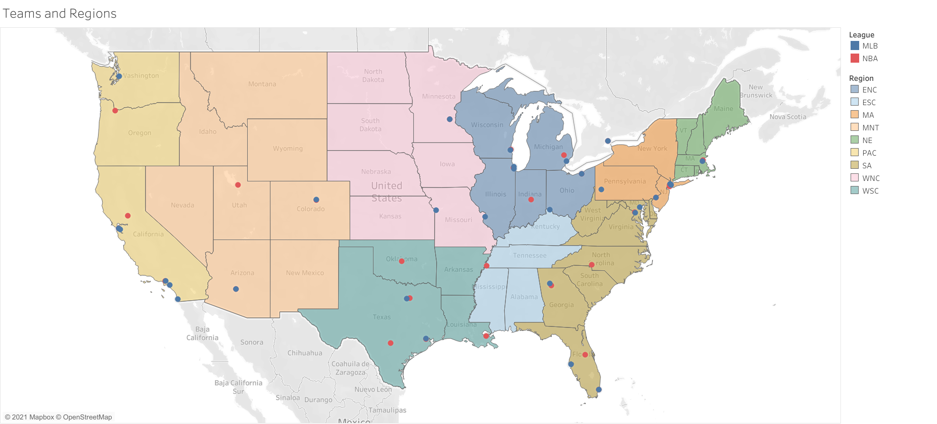
Teams and Regions
Notes:
- This chart shows the distribution of teams across the US.
- We divided the continental US into regions according to census regions.
- As you can see, the teams are clearly not evenly distributed, so the distances of schools to professional teams varies greatly.
-Categorization of states into regions is relevant to the aggregation of college revenue, not professional sports team location.

Slide 7
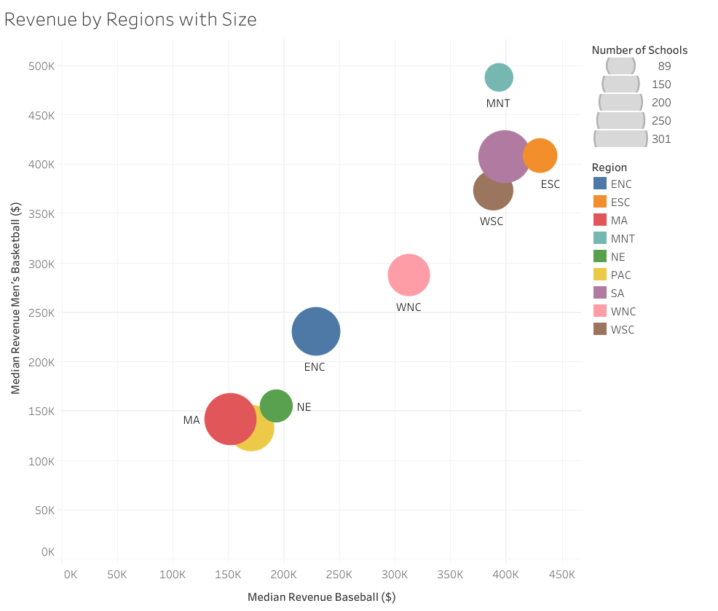
Revenue by Regions
Notes:
- Axes are median revenues for regions.
- Color is region.
- Size is number of schools in that region.
- Not saying there’s a correlation between revenues.
- But does not appear to be correlation between number of schools and revenues.

Slide 8
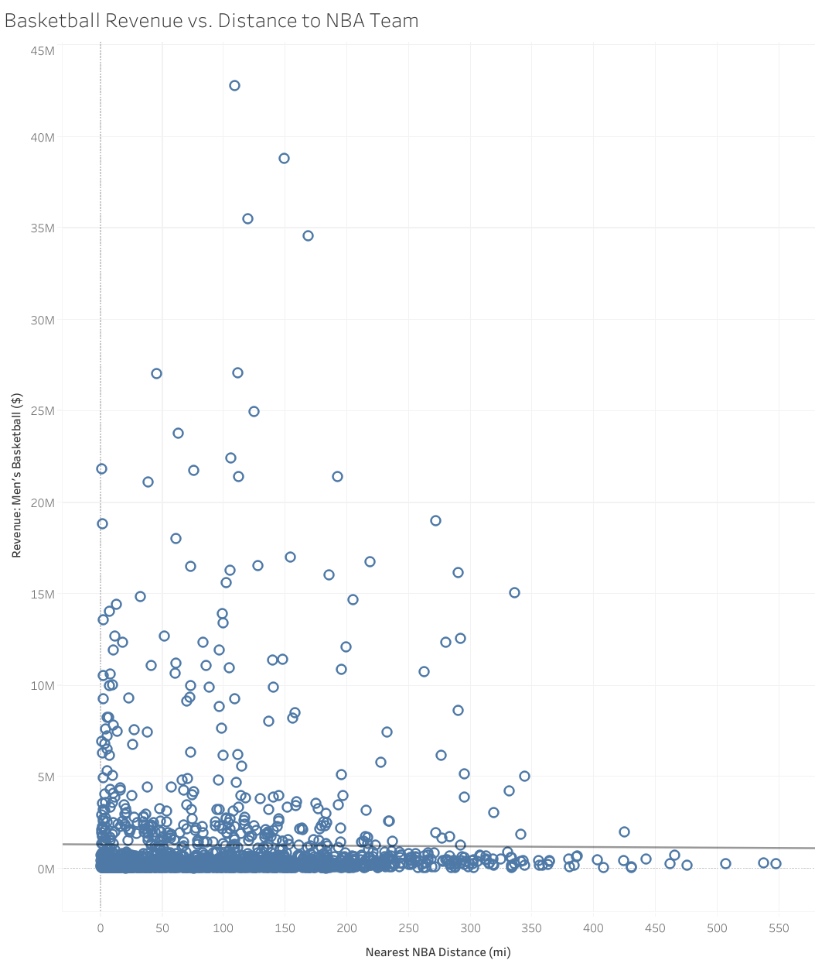
Basketball Revenue vs. Distance to NBA Team
Notes:
-Little obvious correlation for all college basketball teams and distance to nearest professional team. (R2 = 7.8*10^-5, p = .716)

Slide 9
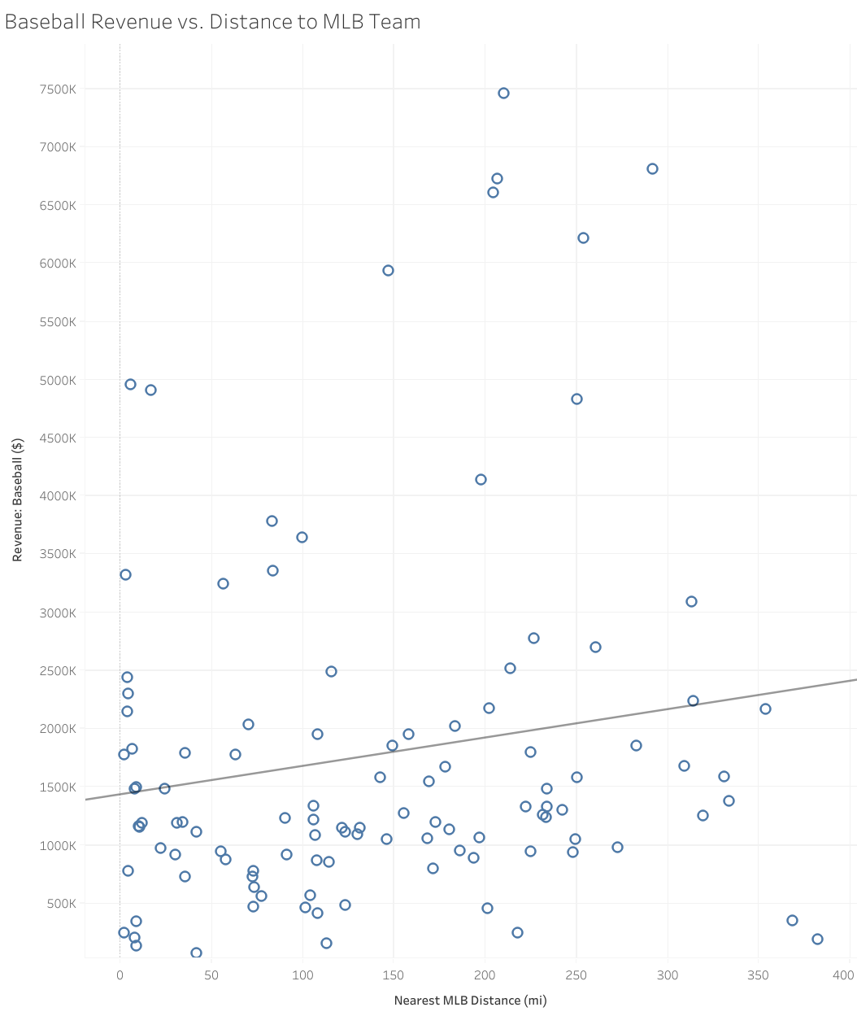
Baseball Revenue vs. Distance to MLB Team
Notes:
- Slightly better for baseball. (.0258 = R2, p = .096)

Slide 10
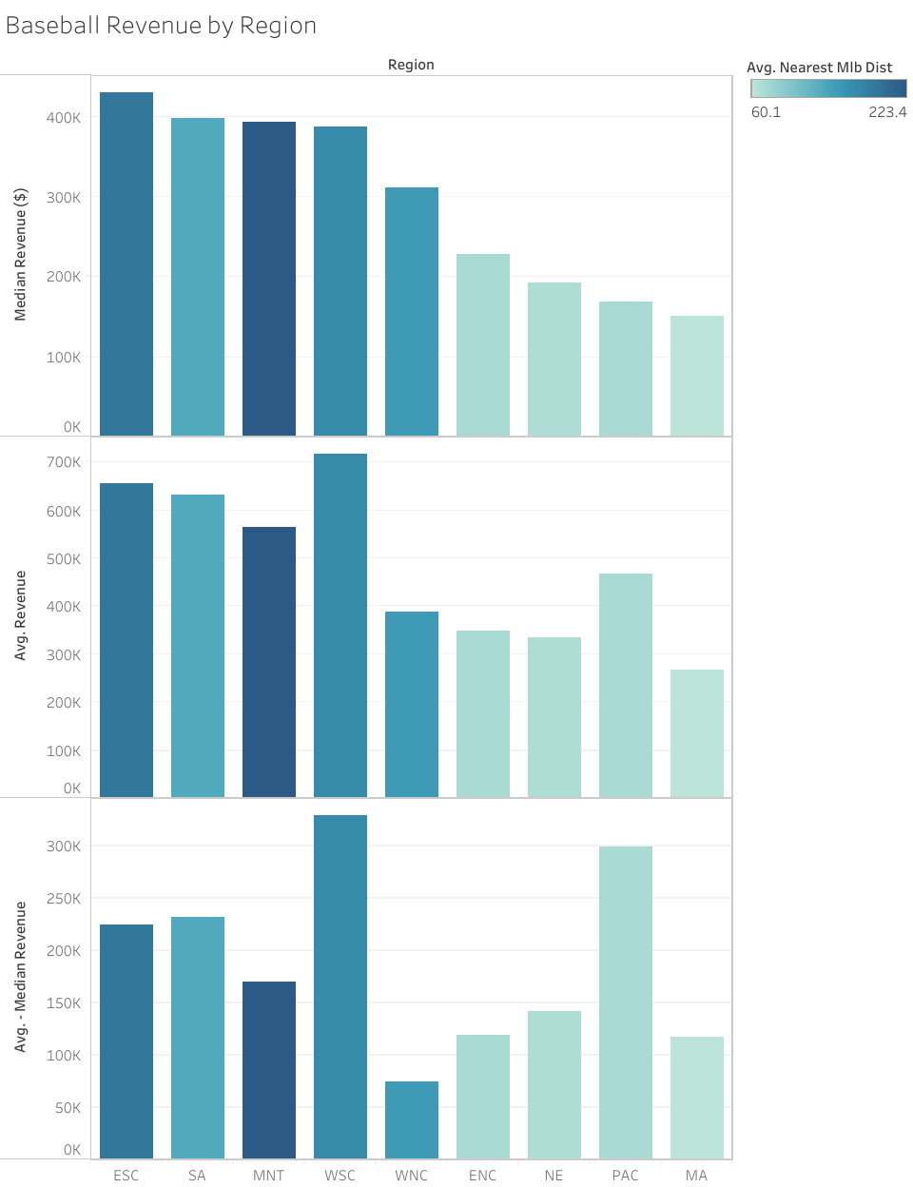
Baseball Revenue by Region
Notes:
- Top chart = median rev by region, middle = mean, bottom = difference
- The darker blue bars are regions with higher avg. dist. the light teal ones are lower.
- When we aggregate by region, the regions with higher avg. distance tend to have higher revenues.

Slide 11
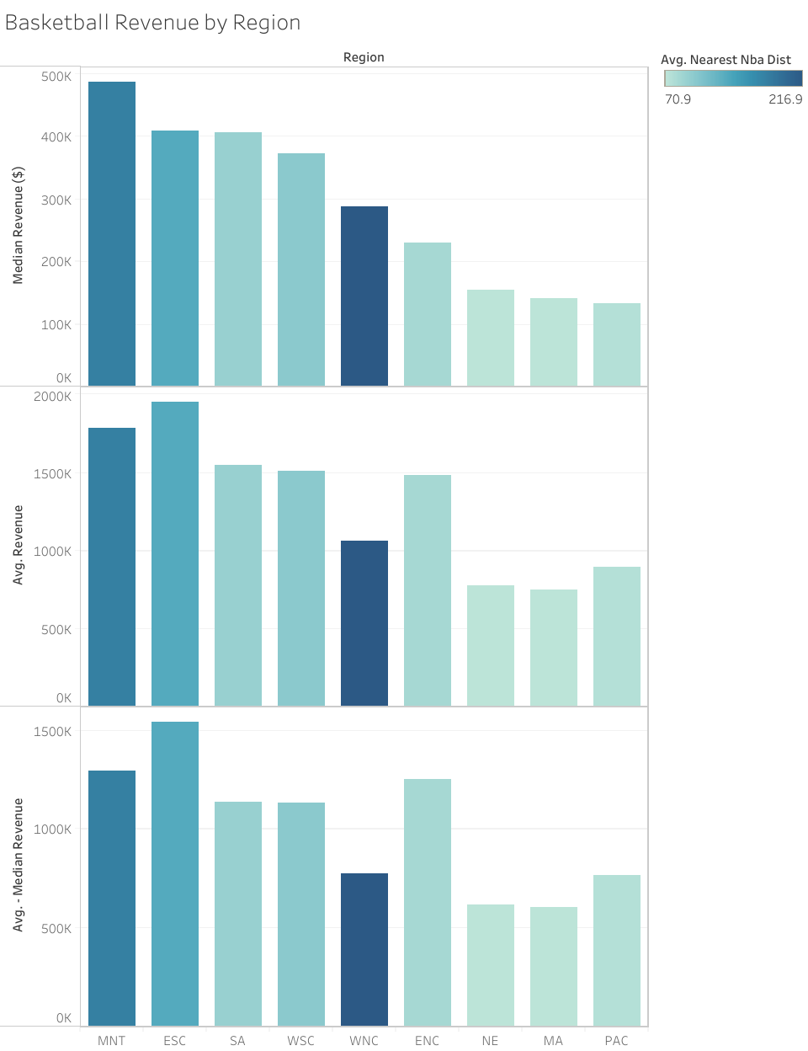
Baseball Revenue by Region
Notes:
- Similar, but not as strong a correlation.

Slide 12
Revenue by Regions
Notes:
- Mountain (MNT, think mountain time zone), East South Central (ESC, Alabama, Tennessee, Mississippi, Kentucky), and South Atlantic (SA, Atlantic coast from Maryland southward.) did well in both revenue categories. They also had the highest avg distance for both sports.

Slide 13
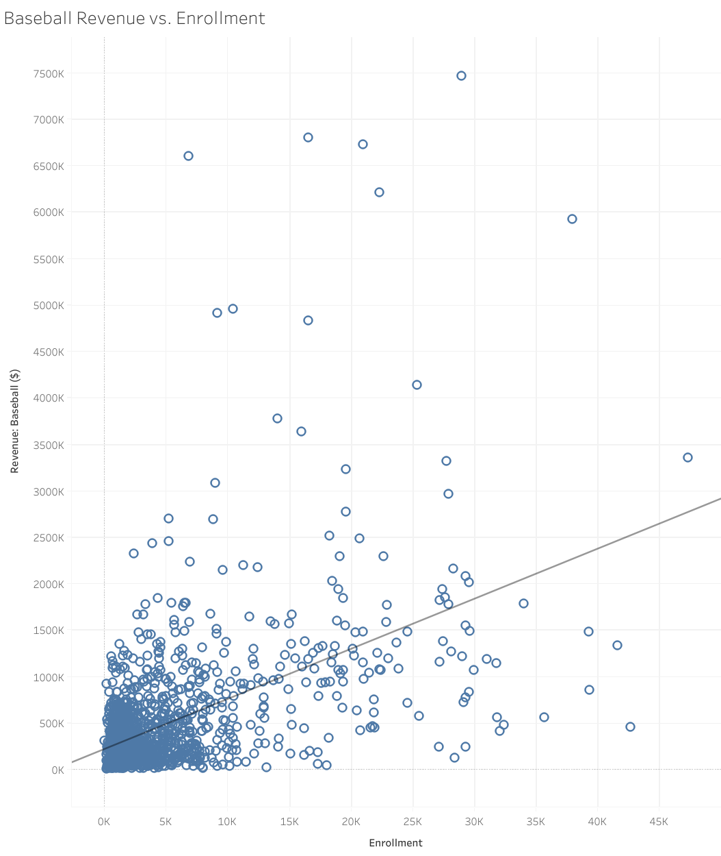
Baseball Revenue vs. Enrollment
Notes:
- Enrollment does seem to correlate better to revenue overall. (R2 = .266, p = .0001)
- Models seemed to suggest that Enrollment, followed by Dist to professional venue were the most important factors***

Slide 14
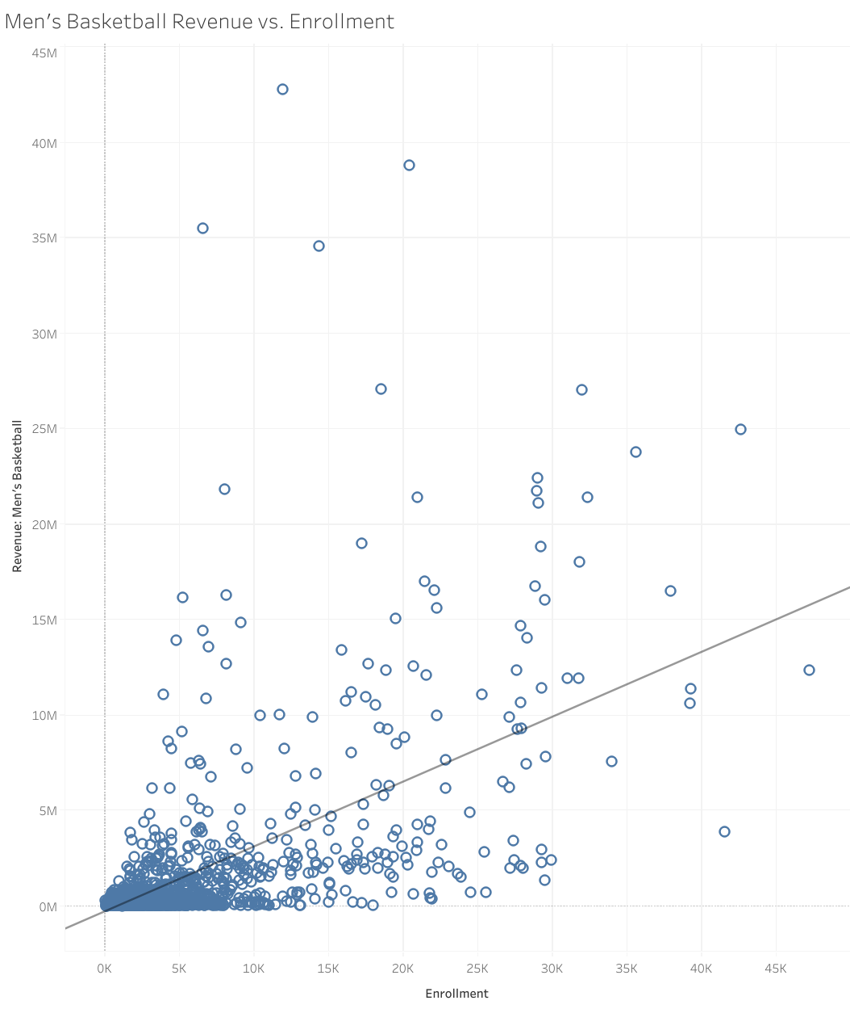
Men’s Basketball Revenue vs. Enrollment
Notes:
- (R2 = .370, p = .0001)

Slide 15
Summary
No correlation between distance from professional teams and revenues for the whole dataset
Notable levels of correlation when the schools are grouped by region suggesting it may be significant factor in determining the revenues for basketball and baseball at a college

